Slide 1
Digitizing FMB/Tippon Using Bhunaksha

Slide 2
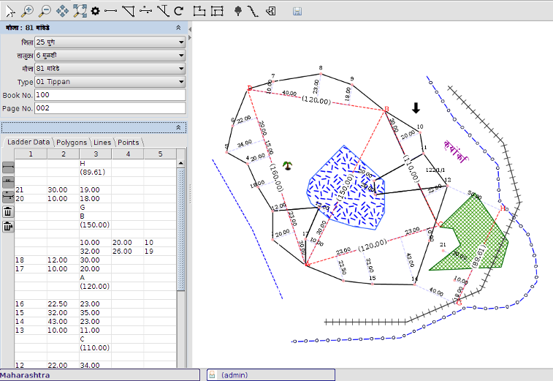
Introduction
Maps can be created interactively from FMB (Field Measurement Book) data and tippon sketch. Once the map is created it will be similar to any other map in Bhunaksha. It can be linked with ROR data, further subdivided and exported to shape file.

Slide 3
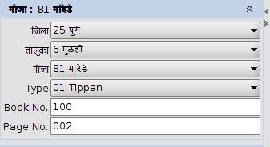
Creation of FMB Maps
From Bhunaksha desktop open “Compose FMB Data” module and select the Village and survey number for which FMB Data is being entered

Slide 4
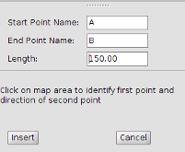
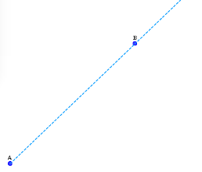
Draw Base line
Start drawing base line using the base line creation tool. The system will prompt for name of base line and its length.
Use mouse to place base line of screen with correct orientation.

Slide 5
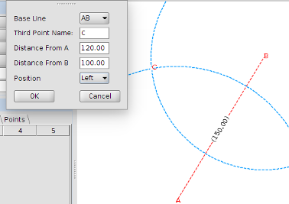
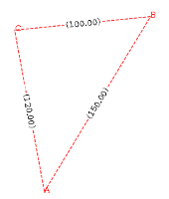
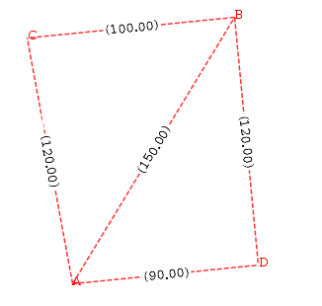
Create Triangle
Triangles can be created by using Triangle creation tool.
1) Select the base line.
2) Enter name of the third point of triangle.
3) Enter the distances from two points of the selected baseline to third point of the triangle.
4) Select the position of the third point.
5) Click OK to draw the triangle.
Repeat the process for more triangles

Slide 6
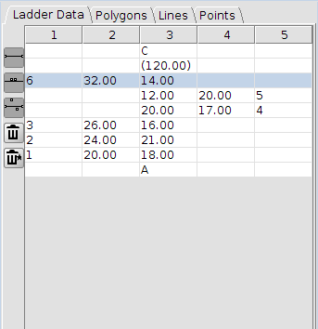
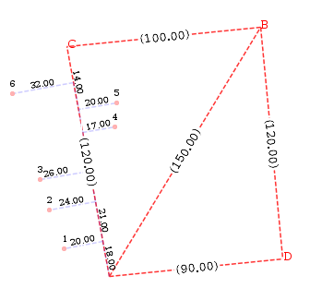
Enter Ladder Data
Click the tool to create offset point and select the base line for which to enter ladder data. Initial entries of ladder data will be populated to ladder table. You can start entering length and offset point details in ladder table. The points will appear automatically in map once you start filling ladder table.

Slide 7
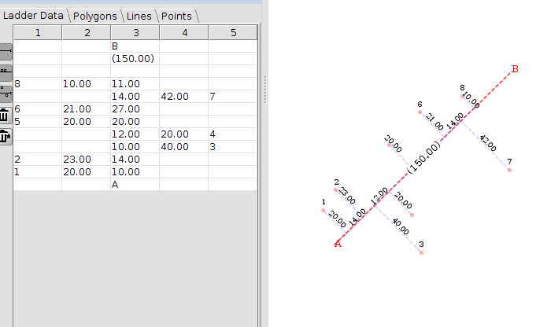
Bombay Style
The procedure for creating base line in Bombay style is almost similar to the process defined above. In Bombay style there may not be any proper triangle involved. Offset points can be entered on a single base line, extended line and hanging base line.

Slide 8
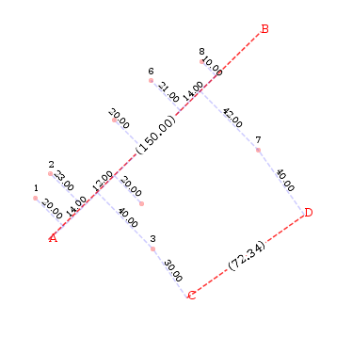
Hanging Base Line
Base lines hanging from other base points or offset points can be created
1. Select first and last point from which the hanging baseline is to be drawn. These may be two offset points.
2. Enter distance from the selected two points to the hanging base line.
3. Enter name of points on hanging base line.
4. Select the hanging base line from the list of options which meet the entered criteria.

Slide 9
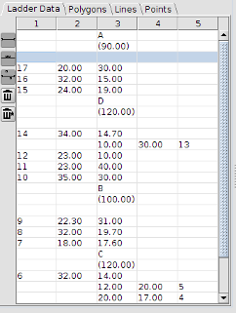
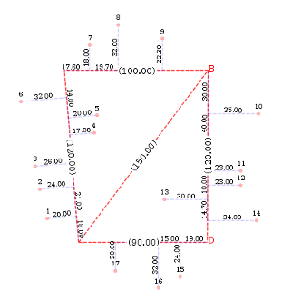
Ladder table entries can be entered on all kind of lines.

Slide 10
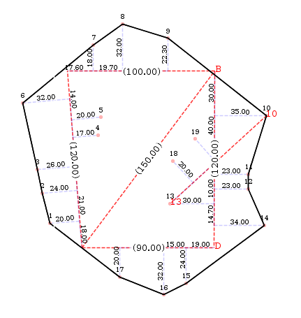
Joining Boundary
Select the tool and click on series of points that contribute to boundary of survey number.

Slide 11
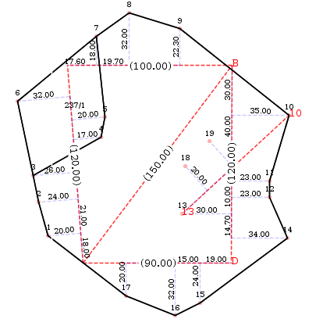
Subdivision
To create sub division select the tool and click on the points in a series. The subdivision will automatically appear in the polygon table once the line created by clicking the series of points will contribute to a valid sub polygon of the boundary polygon. You can assign the number to the newly created sub division

Slide 12
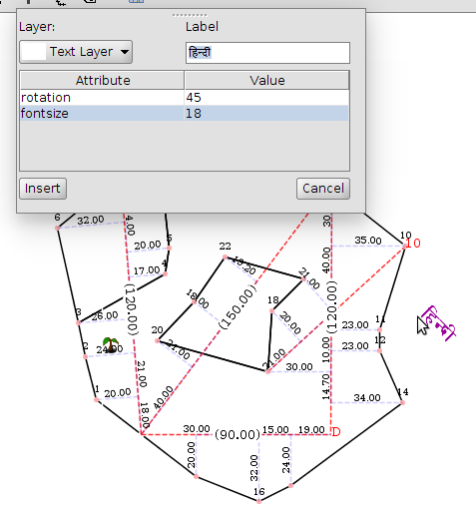
Insert Point Layer
Select the tool.
Select Category (Layer Name) of the point.
Enter other attributes if any
Use mouse pointer to place the point layer at proper place.

Slide 13
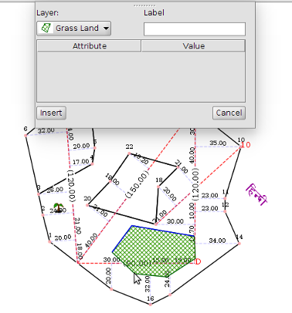
Line Layers & Polygon Layers
Follow similar procedure for drawing line or polygon layers on the field.

Slide 14
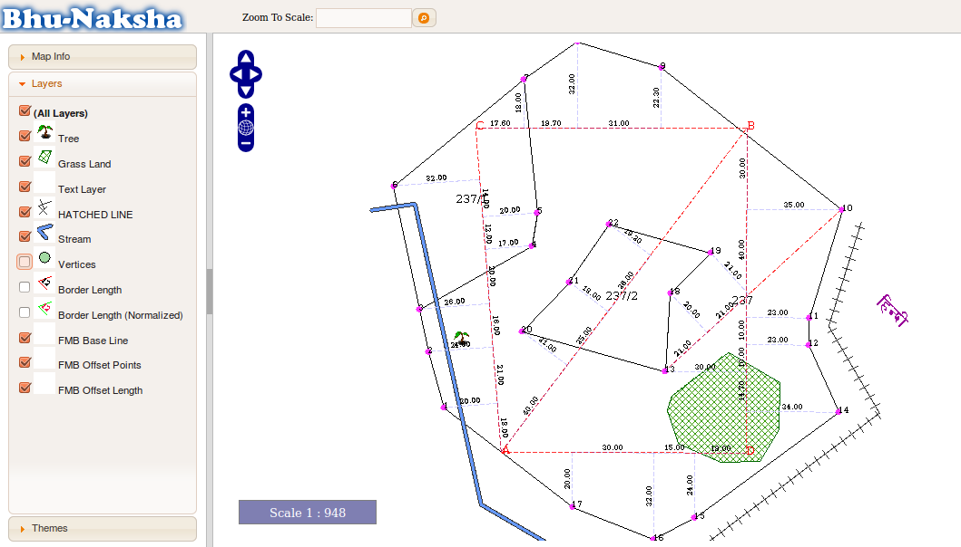
Viewing & Printing Maps created from FMB
Maps created by FMB are quite similar to maps created by other methods like importing from shape file. Base line and offset points will be shown as derived layer. The map and its layers will be available in all display, printing and export modules of Bhunaksha

